Slide 1

Graphical Summaries of Data
Chapter 2

Slide 2
Objectives
Read textbook sections 2.1 - 2.4.
Find the frequencies and relative frequencies of both qualitative and quantitative data.
Understand how to read graphs and answer questions about the data values they represent.
❏ Know how to construct certain graphs in R Studio.
❏ Understand the characteristics of well-made graphs versus misleading graphs.

Slide 3
Summary
A graphical summary is a picture, which they say is worth 1,000 words. The type of graph you choose to represent your variable depends on the variable type (quantitative versus qualitative), variable subtype, and scale. All working STEM professionals should be able to read and interpret graphs in detail. Creating graphs in R Studio is easy and valuable. All graphs and tables should include certain details and avoid misleading characteristics.

Slide 4
Per Variable Type
For Qualitative Data
❏ Frequency tables
❏ Relative frequency tables
❏ Bar charts (aka bar plots)
❏ Vertical and horizontal
❏ Pareto
❏ Side-by-side
❏ Stacked and 100% stacked
❏ Pie charts
For Quantitative Data
❏ Frequency tables
❏ Relative frequency tables
❏ Histograms
❏ Continuous
❏ Discrete
❏ Stem-and-leaf plots
❏ Split stem-and-leaf
❏ Back-to-back
❏ Time-series plots

Slide 5

Frequency Tables for Qualitative Data
Frequency – The number of items in each category; the count or tally.
Relative frequency – The proportion of each category relative to the whole; the counts divided by the total number in the entire sample or population.
$$relative frequency= \frac{frequency}{sum of all frequencies }$$

Slide 6
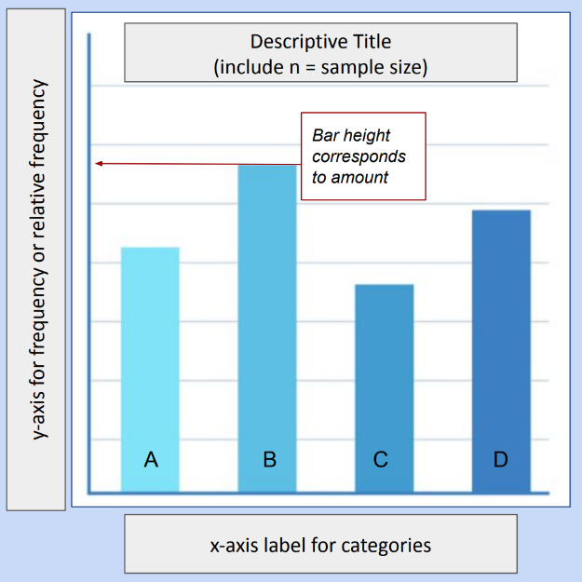
Bar Graphs (Bar Plots)
Bar graphs display the frequency or
relative frequency of each category for
qualitative variables. Each bar is the
same width, and the bars do not touch
one another. The x-axis shows the
category labels. The y-axis shows the
frequency or relative frequency,
depending on what you prefer to
display.

Slide 7
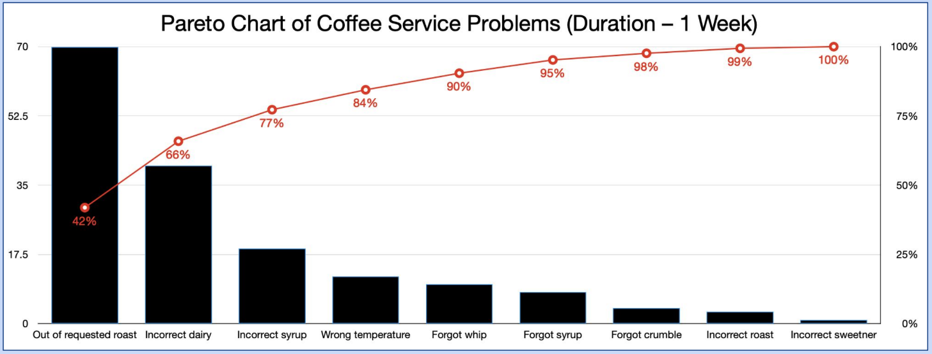
Pareto Charts
Bar graphs with columns in decreasing order are called Pareto charts. They make it easy to know the highest and lowest categories.

Slide 8
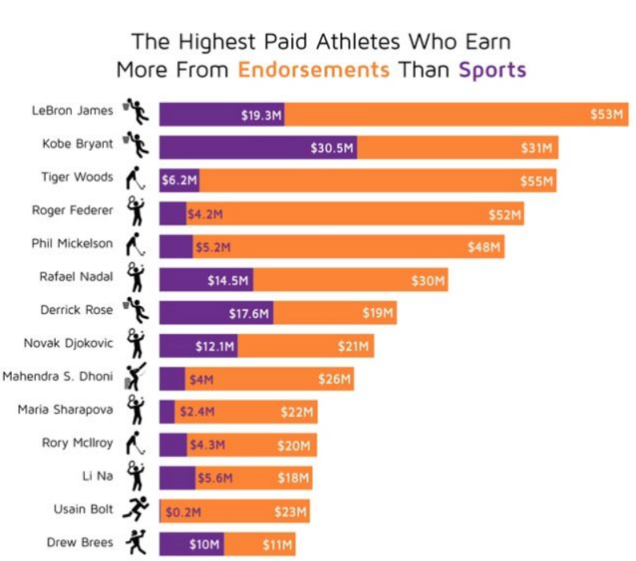
Horizontal Bar Charts
The information
on the x- and y- axes
is switched.
Why is this a benefit
here?

Slide 9
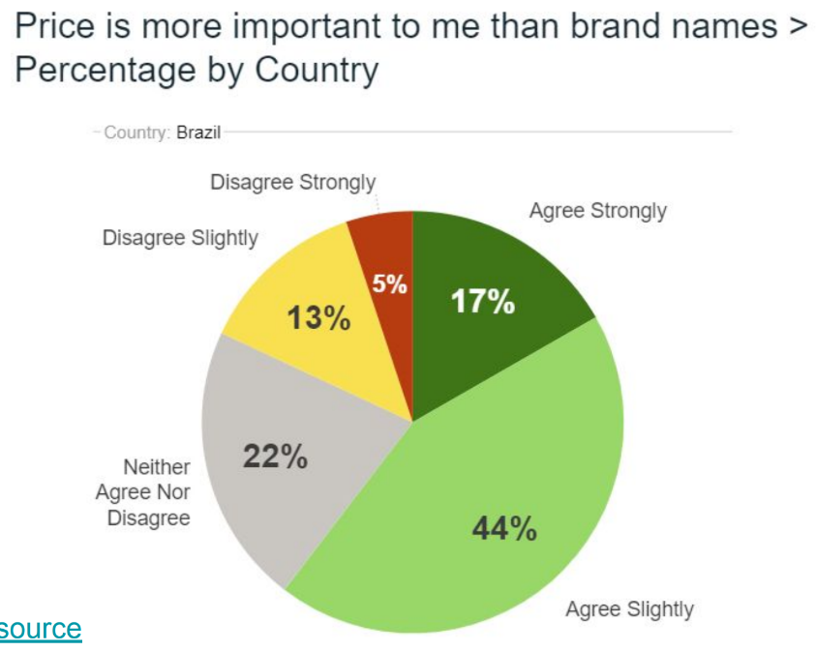
Pie Charts
Pie charts must be made with relative frequencies! The slices of the circle graph display the proportion of each category (either in decimals or percentages).

Slide 10

Frequency Tables for Quantitative Data
Frequency – The number of items in each class; the count or tally.
Relative frequency – The proportion of each class relative to the whole; the counts divided by the total number in the entire sample or population.
$$relative frequency= \frac{frequency}{sum of all frequencies }$$

Slide 11
Frequency Distributions
The data values are grouped into classes (also called bins).
Lower class limit – the smallest value in each class.
Upper class limit – the largest value in each class.
Class width – the difference between two consecutive lower class limits.
The class width is consistent between all consecutive classes. Every single data value must fit into one class. The classes must have equal widths and must not overlap. Do not leave gaps. Even if a class does not have any data values, we must include it with a frequency of zero.

Slide 12
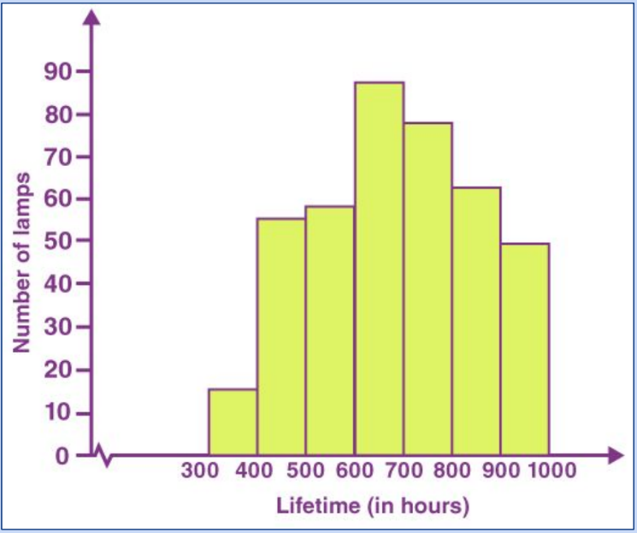
Histograms
Histograms display the frequency
distributions for quantitative data. Each
bar represents either frequency or
relative frequency per class. The lower
class limits are shown on the x-axis.
There are NO spaces between the bars
and no gaps between classes. The
number of classes changes how the
data looks – avoid including too much
or too little detail.

Slide 13
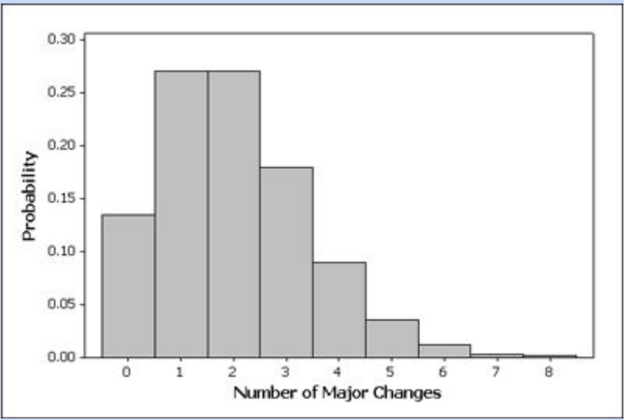
Discrete Histograms
The x-axis displays a single value per class. “Number of changes” is discrete, so technically the lower class limit and upper class limit are the same in each class.

Slide 14
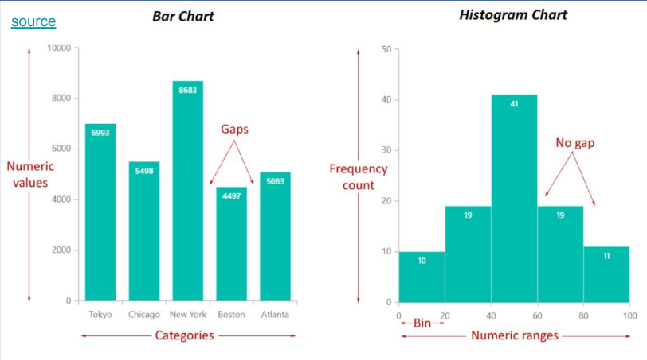
Know the Difference!
Bar Graphs ≠ Histograms

Slide 15
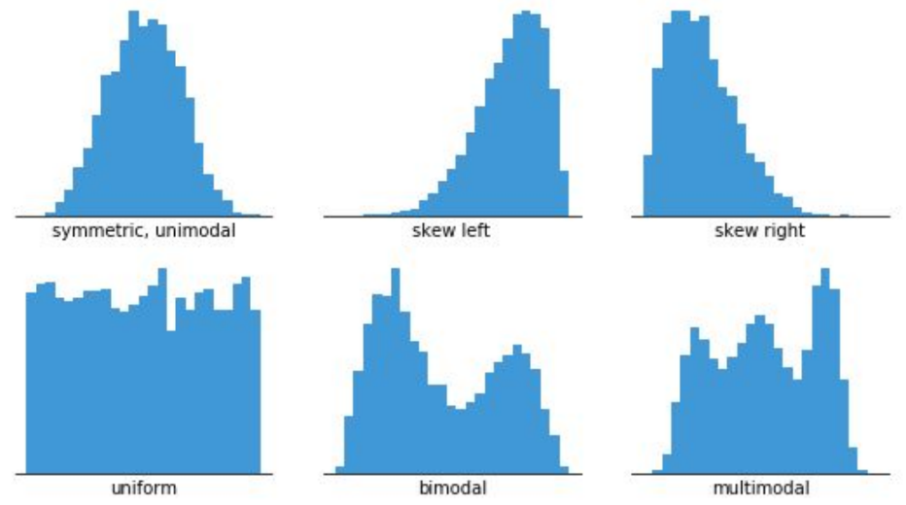
Histogram Shapes
Skewed vs. Symmetric
  Symmetric
  Left-skewed
  Right-skewed
Number of Modes
  Unimodal
  Bimodal
  Multimodal
Uniform
Bell-shaped

Slide 16
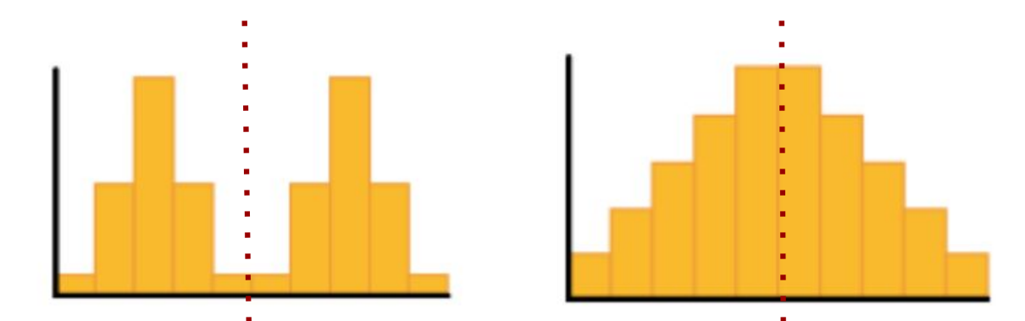
Symmetric
If the histogram were folded in half vertically, it would create a mirror image on the right and left sides. Can be exact or approximate.

Slide 17
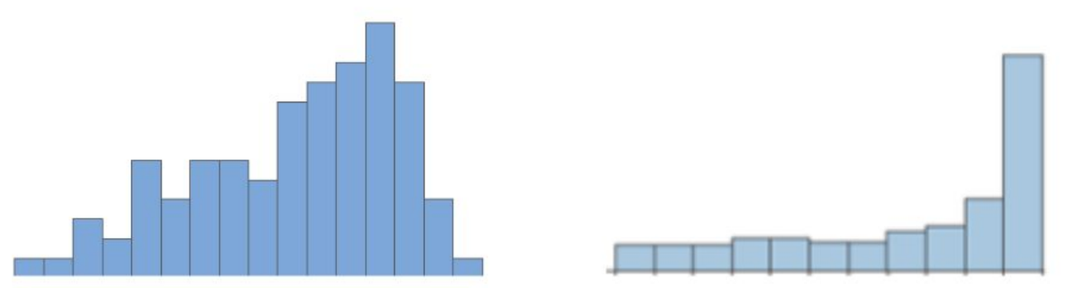
Skewness (Negative)
When most of the data values are larger but there is a longer left tail. Example: A researcher conducts a survey of elderly people about their age of retirement. Because the majority of people retire in their mid 60s or older, the distribution would be negatively skewed.

Slide 18
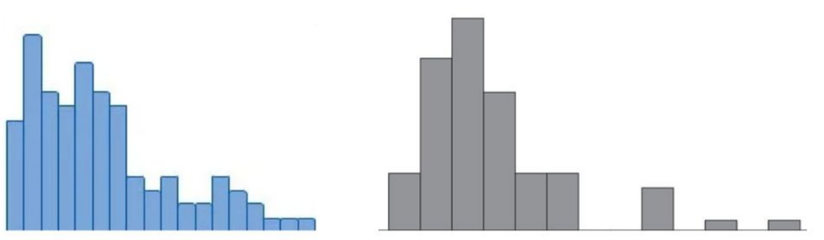
Skewness (Positive)
When most of the data values are smaller but there is a longer right tail. Example: The distribution of the number of pets that households own in any particular city is likely to be right skewed.

Slide 19
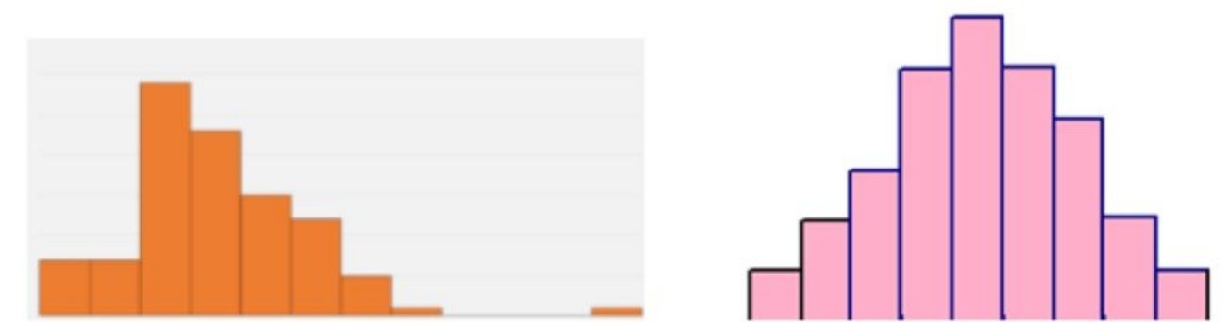
Unimodal
When there is one distinct mode or peak. Example: The average ACT score for high school students in the U.S. is about a 21 with some students scoring less and some scoring higher.

Slide 20
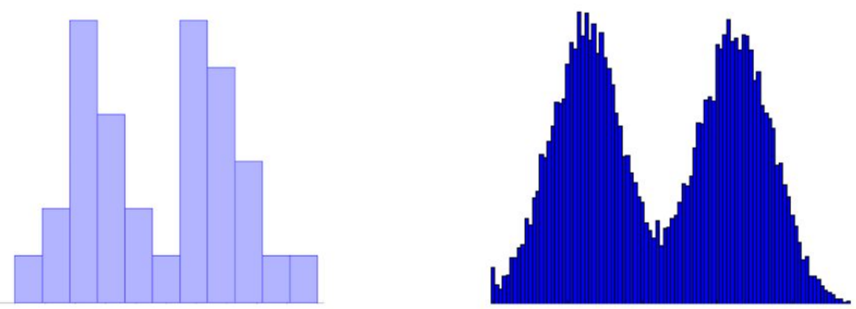
Bimodal
When there are two distinct modes or peaks. Example: If you created a graph to visualize the distribution of customers at a certain restaurant by hour, you’d likely find that it follows a bimodal distribution with a peak during lunch hours and another peak during dinner hours.

Slide 21
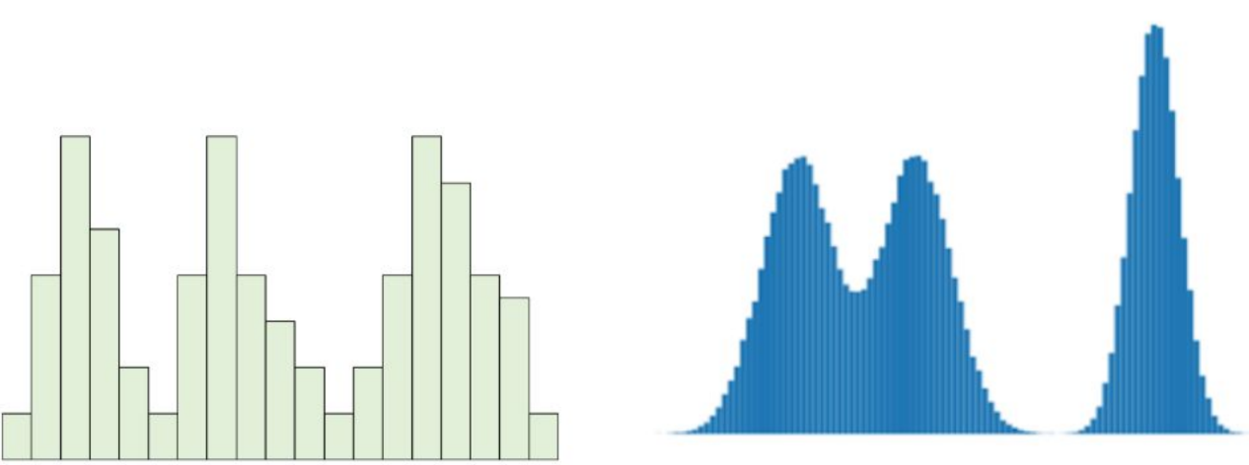
Multimodal
When there are three or more distinct modes/peaks. Example: We measure the speed of cars on a multilane highway. Each lane could have a different mode.

Slide 22
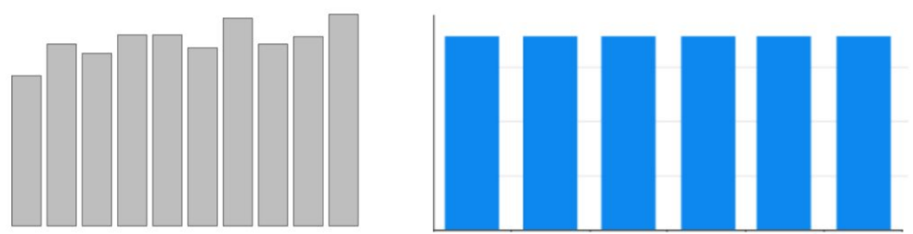
Uniform
Every bar is roughly the same height (all classes have the same frequency). They are inherently symmetric and have no modes. Example: Suppose a basketball stadium holds a raffle in which it will randomly select one seat number out of 10,000 possible seats in the stadium and give the patron in that seat number a prize. The probability that any individual seat is chosen follows a uniform distribution.

Slide 23
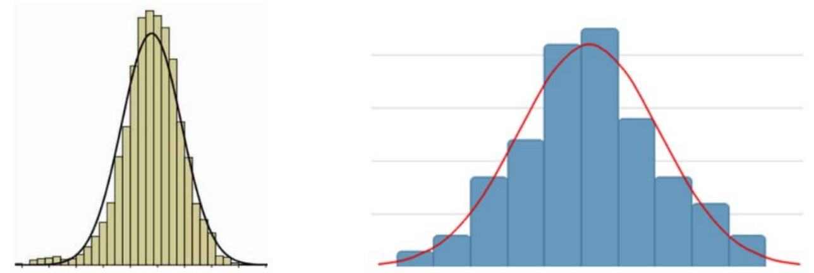
Bell-Shaped (Normal)
When the histogram is unimodal and symmetric. Example: the volume of milk production from dairy cows.

